Slide 1
Introduction to Artificial Intelligence
Litty Tressa George
Lecturer FICT
Section 1 PPT 2

Slide 2
Subsets of Artificial Intelligence
Following are the most common subsets of AI:
Machine Learning
Deep Learning
Natural Language processing
Expert System
Robotics
Machine Vision
Speech Recognition
Note: Among all of the above, Machine learning plays a crucial role in AI. Machine learning and deep learning are the ways of achieving AI in real life.

Slide 3
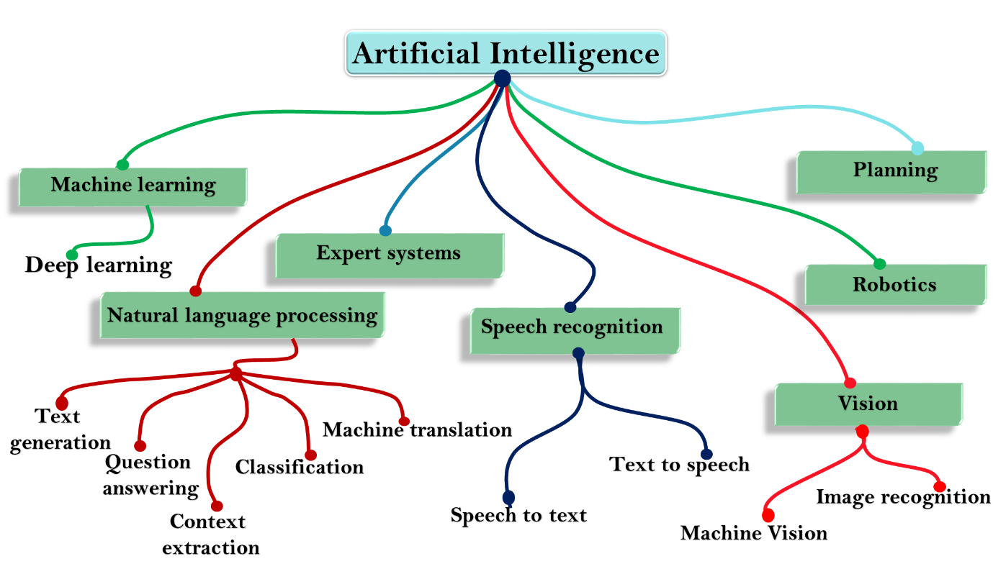
Fig: Subsets of Artificial Intelligence

Slide 4
Machine Learning
Machine learning is a part of AI which provides intelligence to machines
with the ability to automatically learn with experiences without being explicitly programmed.
It is primarily concerned with the design and development of algorithms that allow the system to learn from historical data.
Machine Learning is based on the idea that machines can learn from past data, identify patterns, and make decisions using algorithms.
Machine learning algorithms are designed in such a way that they can learn and improve their performance automatically.
Machine learning helps in discovering patterns in data.

Slide 5
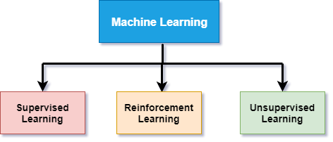
Machine Learning Types

Slide 6
Supervised Learning:
Supervised learning is a type of machine learning in which machine learn from known/labelled datasets (set of training examples), and then predict the output.
Fully labeled means that each example in the training dataset is tagged with the answer the algorithm should come up with on its own.
For example, a labeled dataset of flower images would tell the model which photos were of roses, daisies and daffodils. When shown a new image, the model compares it to the training examples to predict the correct label
A supervised learning agent needs to find out the function that matches a given sample set.
For example, a supervised machine learning system that can learn which emails are ‘spam’ and which are ‘not spam’. The algorithm would be first trained with available input data set (of zillions of emails) that is already tagged with this classification to help the machine learning system learn the characteristics or parameters of the ‘spam’ email and distinguish it from those of ‘not spam’ emails.
Supervised learning further can be classified into two categories of algorithms:
Classifications
Regression

Slide 7
Reinforcement learning:
Reinforcement learning is a type of learning in which an AI agent is trained by giving some commands, and on each action, an agent gets a reward as a feedback.
Using these feedbacks, agent improves its performance.
Reward feedback can be positive or negative which means on each good action, agent receives a positive reward while for wrong action, it gets a negative reward.
Video games are full of reinforcement cues. Complete a level and earn a badge. Defeat the bad guy in a certain number of moves and earn a bonus. Step into a trap — game over.
These cues help players learn how to improve their performance for the next game. Without this feedback, they would just take random actions around a game environment in the hopes of advancing to the next level..
Reinforcement learning is of two types:
Positive Reinforcement learning
Negative Reinforcement learning

Slide 8
Unsupervised learning:
This is an ‘unaided’ type learning when your data typically has no known output labels or any feedback loop.
The training dataset is a collection of examples without a specific desired outcome or correct answer.
The neural network then attempts to automatically find structure in the data by extracting useful features and analyzing its structure.
Unsupervised learning is associated with learning without supervision or training.
In unsupervised learning, the algorithms are trained with data which is neither labeled nor classified.
In unsupervised learning, the agent needs to learn from patterns without corresponding output values.
The system has to understand itself from the data set we provide and then generate some rule to classify.
In general, unsupervised learning is a bit difficult to implement and thus it’s not used as widely as supervised learning.
Unsupervised learning algorithms can be classified into two categories of algorithms:
Clustering
Association

Slide 9
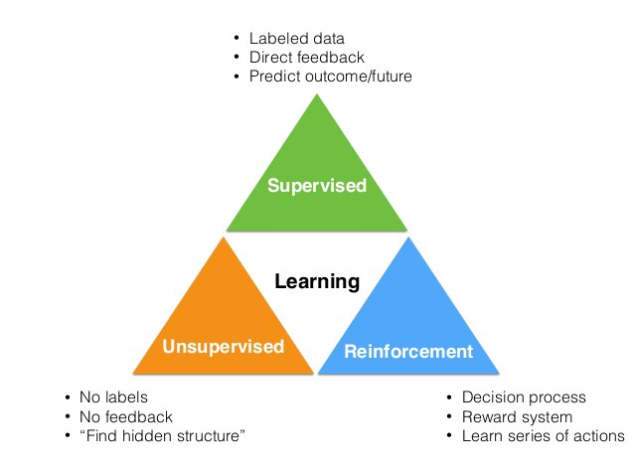
Machine Learning Types

Slide 10
Deep Learning
Deep learning is a subset of machine learning which provides the ability to machine to perform human-like tasks without human involvement.
It provides the ability to an AI agent to mimic the human brain.
Deep learning can use both supervised and unsupervised learning to train an AI agent.
Deep learning is implemented through neural networks architecture hence also called a deep neural network.
Deep learning is the primary technology behind self-driving cars, speech recognition, image recognition, automatic machine translation, etc.
The main challenge for deep learning is that it requires lots of data with lots of computational power.

Slide 11
How deep learning works:
Deep Learning Algorithms work on deep neural networks, so it is called deep learning.
These deep neural networks are made of multiple layers.
The first layer is called an Input layer, the last layer is called an output layer, and all layers between these two layers are called hidden layers.
In the deep neural network, there are multiple hidden layers, and each layer is composed of neurons.
These neurons are connected in each layer.
The input layer receives input data, and the neurons propagate the input signal to its above layers.
The hidden layers perform mathematical operations on inputs, and the performed data forwarded to the output layer.
The output layer returns the output to the user.

Slide 12
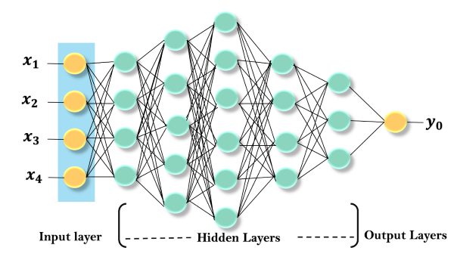
Fig: Deep Neural Networks

Slide 13
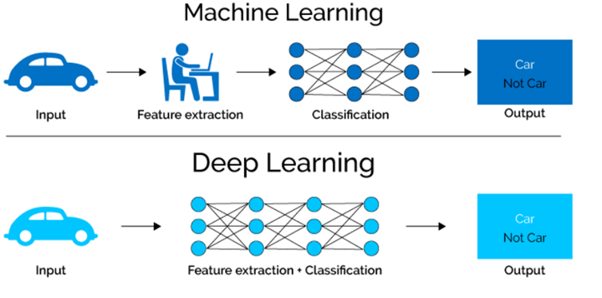

Slide 14
Natural Language Processing
Natural language processing is a subfield of computer science and artificial intelligence.
NLP enables a computer system to understand and process human languages.
NLP plays an important role in AI as without NLP, AI agent cannot work on human instructions, but with the help of NLP, we can instruct an AI system on our language.
Today we are all around AI, and as well as NLP, we can easily ask Siri, Google or Cortana to help us in our language.
Natural language processing application enables a user to communicate with the system in their own languages directly.
The Input and output of NLP applications can be in two forms:
Speech
Text

Slide 15
Expert Systems
An expert system is an application of artificial intelligence.
In artificial intelligence, expert systems are the computer programs that rely on obtaining the knowledge of human experts and programming that knowledge into a system.
Expert systems emulate the decision-making ability of human experts.
These systems are designed to solve the complex problem through bodies of knowledge rather than conventional procedural code.
One of the examples of an expert system is a suggestion for the spelling error while typing in the Google search box.
Following are some characteristics of expert systems:
High performance
Reliable
Highly responsive
Understandable

Slide 16
Robotics
Robotics is a branch of artificial intelligence and engineering which is used for designing and manufacturing of robots.
Robots are the programmed machines which can perform a series of actions automatically or semi-automatically.
AI can be applied to robots to make intelligent robots which can perform the task with their intelligence.
AI algorithms are necessary to allow a robot to perform more complex tasks.
Nowadays, AI and machine learning are being applied on robots to manufacture intelligent robots which can also interact socially like humans.
One of the best examples of AI in robotics is Sophia robot.

Slide 17
Machine Vision
Machine vision is an application of computer vision which enables a machine to recognize the object.
Machine vision captures and analyses visual information using one or more video cameras, analog-to-digital conversations, and digital signal processing.
Machine vision systems are programmed to perform narrowly defined tasks such as counting objects, reading the serial number, etc.
Computer systems do not see in the same way as human eyes can see, but it is also not bounded by human limitations such as to see through the wall.
With the help of machine learning and machine vision, an AI agent can be able to see through walls.

Slide 18
Speech Recognition:
Speech recognition is a technology which enables a machine to understand the spoken language and translate into a machine-readable format.
It can also be said as automatic Speech recognition and computer speech recognition.
It is a way to talk with a computer, and on the basis of that command, a computer can perform a specific task.
This softwares requires unambiguous spoken language to understand and perform specific task.
Today's there are various software or devices which contains speech recognition technology such as Cortana, Google virtual assistant, Apple Siri, etc.
We need to train our speech recognition system to understand our language.
In previous days, these systems were only designed to convert the speech to text, but now there are various devices which can directly convert speech into commands.

Slide 19
Advantages of Artificial Intelligence
Reducing Human Error
. The phrase “human error” was born because humans make mistakes from time to time.
Computers however, do not make these mistakes if they are programmed properly.
With Artificial intelligence, the decisions are taken from the previously gathered and structured information applying certain set of algorithms.
So errors are reduced and there is a higher chance of reaching accuracy with a greater degree of precision
Example: Weather Forecasting using AI have reduced majority of human error.
By using deep learning mathematical models, AI could learn from past weather records to predict the future.

Slide 20
2) Takes risks instead of Humans
This is one of the biggest advantage of Artificial intelligence.
We can overcome many risky limitations of human by developing an AI Robot which in turn can do the risky things for us.
Let it be going to mars, defuse a bomb, explore the deepest parts of oceans, mining for coal and oil, it can be used effectively in any kinds of natural or man made disasters.
Example: Nuclear explosions , chemical explosions , natural calamities etc..
AI Robots can be used in such situations where an human intervention can be hazardous.

Slide 21
3) Availability 24×7
An Average human will work for 4-6 hours a day excluding the breaks.
Humans are built in such a way to get some time out for refreshing themselves and get ready for a new day of work and they even have weekly off’s to stay intact with their work life and personal life.
But using AI we can make machines work 24×7 without any breaks and they don’t even get bored unlike humans.
Example: Call Centeres & Helpline centers of Educational Institutes, Hospitals, Hotels , Bank, etc; are getting a lot of queries and issues 24×7 which can be handled effectively using AI.

Slide 22
4) Helping in Repetitive Jobs
In our day-to-day work, we will be performing many repetitive works like sending a thanking mail, verifying certain documents for errors etc.
Using artificial intelligence we can productively automate these tasks and can even remove “boring” tasks for humans and free them up to be increasingly creative.
Example: In banks, we often see many verifications of documents in order to get a loan which is a repetitive task for the owner of the bank. Using AI Cognitive Automation the owner can speed up the process of verifying the documents by which both the customers and the owner will be benefited.

Slide 23
5) Digital Assistance
Some of the highly advanced organizations use digital assistants to interact with users which saves the need of human resource.
The digital assistant also used in many websites to provide things that user want. We can chat with them about what we are looking for.
Some chatbots are designed in such a way that it becomes hard to determine that we’re chatting with a chatbot or a human being.
Example: We all know that organizations have a customer support team which needs to clarify the doubts and queries of the customers. Using AI the organizations can set up a Voicebot or Chatbot which can help customers with all their queries. We can see many organizations already started using them in their websites and mobile applications.

Slide 24
6) Faster Decisions:
Using AI alongside other technologies we can make machines take decisions faster than a human and carry out actions quicker.
While taking a decision human will analyze many factors both emotionally and practically but AI-powered machine works on what it is programmed and delivers the results in a faster way.
Example: We all have played a Chess game in Windows. It is nearly impossible to beat CPU in the hard mode because of the AI behind that game. It will take the best possible step in a very short time according to the algorithms used behind it.

Slide 25
7) Daily Applications
Daily applications such as Apple’s Siri, Window’s Cortana, Google’s OK Google are frequently used in our daily routine whether it is for searching a location, taking a selfie, making a phone call, replying to a mail and many more.
Example: Around 20 years ago, when we are planning to go somewhere we used to ask a person who already went there for the directions. But now all we have to do is say “OK Google where is Atlanta”. It will show you Visakhapatnam’s location on google map and best path between you and Atlanta

Slide 26
8) New Inventions:
AI is powering many inventions in almost every domain which will help humans solve the majority of complex problems.
Example: Recently doctors are able to predict cancer at its earlier stages using advanced AI-based technologies.

Slide 27
Disadvantages of Artificial Intelligence
High Costs of Creation
As AI is updating every day the hardware and software need to get updated with time to meet the latest requirements. Machines need repairing and maintenance which need plenty of costs. It’ s creation requires huge costs as they are very complex machines.
2) Making Humans Lazy
AI is making humans lazy with its applications automating the majority of the work. Humans tend to get addicted to these inventions which can cause a problem to the future generations.

Slide 28
3) Unemployment:
As AI is replacing the majority of the repetitive tasks and other works with robots, human interference is becoming less which will cause a major problem in the employment standards. Every organization look to replace the minimum qualified individuals with AI robots which can do similar work with more efficiency.
4) No Emotions
There is no doubt that machines are much better when it comes to working efficiently but they cannot replace the human connection that makes the team. Machines cannot develop a bond with humans which is an essential attribute when comes to Team Management.

Slide 29
5) Lacking Out of Box Thinking
Machines can perform only those tasks which they are designed or programmed to do, anything out of that they tend to crash or give irrelevant outputs which could be a major backdrop. No possibility of creative as well as innovative ideas.

